Slide 1


Nomad Tutorial
Romil Bhardwaj, Alvin Ghouas, Prabal Dutta
Please install Docker if you haven’t already

Slide 2
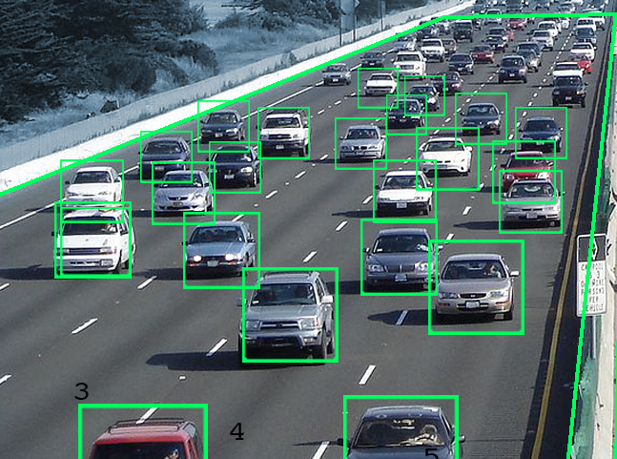

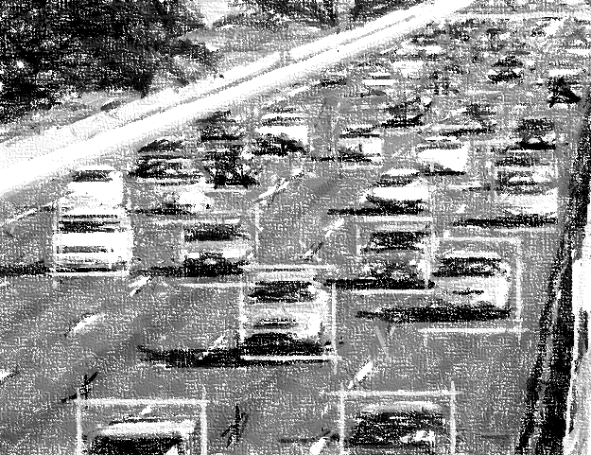
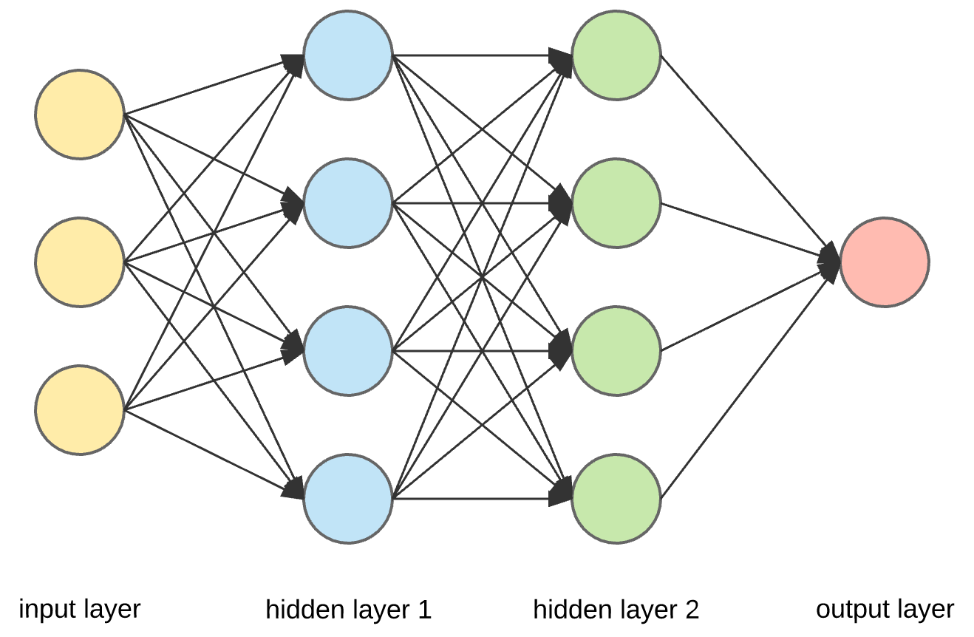



IoT Applications
Can be expressed as a sequential combination of independent operators
=
Traffic Surveillance
Video Capture
Pre-processing
Inference
=
Realtime Translation
Audio Capture
Resampling/Transform
Inference

Slide 3




IoT Application Deployments
Data shipped across the network, processed in the cloud
Monolithic Program
Edge
Gateway
Cloud

Slide 4
But the Infrastructure is diverse
Heterogenous device and network capabilities
Monolithic Program
Underutilized compute resources
Last Mile Network:
Low bandwidth
High latency
Edge
Gateway
Cloud
Notes:
This compute model does not take into account the infrastructure

Slide 5


Introducing Nomad
Partition and intelligently schedule pipelines across edge-cloud
Partitioned Pipeline
Monolithic Program
Reduced network load
Edge
Gateway
Cloud
Notes:
This compute model does not take into account the infrastructure

Slide 6
What Nomad can do for you
Easy pipeline partitioning
Intelligent Scheduling
Define operators as python methods
Run across machines
Manage dependencies with custom container images
Isolation in multi-tenant environments
Nomad profiles your infrastructures and pipelines
Optimizes the end-to-end latency of your pipeline
Fault-tolerance coming soon!

Slide 7

Nomad Programming Model
import nomad def read_sensor(): import random return random.get_image() def preprocess(x): import cv2 new_image = cv2.resize(x) return new_image def run_nnet(x): import nnet_model nnet_model.run(x) def write_result(x): import redis redis.write("result", x) fns = [read_sensor, preprocess, run_nnet, write_result] start = "my_edge" end = "my_cloud" nomad.submit_pipeline(fns, start, end)
Video Capture
=
Preprocessing
Inference
Write Result

Slide 8
Infrastructure Aware Scheduling
Goal: Maximize pipeline throughput while satisfying the hard placement constraints and minimizing latency
Placement can be reduced to a minimization problem: Find the shortest walk of length k, from node s to node d.
Constraints: s: First node of the pipeline, d: Last node of the pipeline, k: Number of operators
Parameters: Worker CPU capacity, network throughput and latencies, Operator CPU requirements and message sizes
Solution: Recursive algorithm to exhaustively evaluate all possible placements and pick the minimal cost path
Op0
Op1
Op2
Sensor Data
Network
Cost
Network
Cost
Result
Compute Cost
Compute Cost
Compute Cost
Pipeline Operators
Node 0
Network Link
Node 1
0
1
Node 3
Node 2
2
Network Overview

Slide 9
Notes
Supports linear dataflow graphs
Trees, DAGs coming soon
Supports stateless operators
We’re still developing Nomad and would love to hear your feedback
Feel free to file issues at https://github.com/romilbhardwaj/nomad
Or send an email to romilb@eecs.berkeley.edu.

Slide 10
Tutorial
Random Int Generator
f(x) = x²
Write to DB
https://github.com/romilbhardwaj/nomad/blob/master/tutorial/tutorial.md

